Slide 1












2620 SERIES
6x2 LA
BUILD YOUR OWN TRUCK
2620 HG
2620 HM
2620 HU
2620 HN
Best-in-class | Superior Tyre | Higher Reliability & | Better Productivity & | Higher Safety | Choice of cabins | Overall TCO
fluid efficiency | Mileage | Low Maintenance Cost | Performance |  | and loading spans | advantage

Slide 2

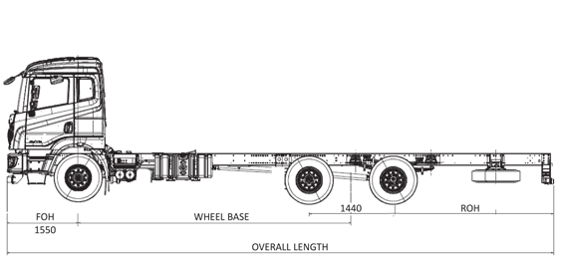



SPECIFICATIONS
Engine type
MAJOR DIMENSIONS
H series BS-VI with i-Gen6 technology
Loading span | 7.4 m | 8.1 m | 8.7 m | 9.3 m | 9.7 m
Wheelbase | 5130 mm | 5430 mm | 5880 mm | 5880 mm | 6180 mm
Overall length | 9710 mm | 10360 mm | 10960 mm | 11560 mm | 11960 mm
Turning circle dia | 20.2 m | 22 m | 22.9 m | 23.8 m | 24 m
Overall width | 2570 mm
Overall height | M - 2987 mm / U - 3247 mm / N(WIM) - 3177 mm
Max power
147 kW @ 2400 rpm
Max torque
700 Nm @ 1200 - 1900 rpm
Clutch
380 mm dia - with air assisted hydraulic booster
Gearbox
6 speed synchromesh gearbox Forged I section - Reverse Elliot type Fully floating, single speed rear axle
Front axle
Rear axle
Front suspension
Semi-elliptic multi leaf Optional: Parabolic springs
SCHEMATIC LAYOUT
Rear suspension
Semi-elliptic multi leaf with parabolic helper springs
Chassis frame
HSS material with new improved design
Brakes
Full air dual line brakes with ABS
Fuel tank
Cross linked polymer Capacity: 375 L on LH side
For POL variants: 300 L on RH side
DEF tank
48 L
APPLICATIONS
Specifications & images are indicative and subject to change. Jan’23
Max speed
80 kmph (60 kmph for POL variants)
Electricals
24 V - 120 Ah (150 Ah for AC Models)
Tyres
295/ 90 R 20
Cabin
G - Economy Cowl, M - Economy cabin, U - Value cabin and N - Premium cabin, AC option on U and N variants
e Commerce
Logistics
Parcel
Tanker
Market load
Vehicle configuration options
Cowl & chassis/ Cabin & chassis
Chassis weight (Laden)
FAW - 7,000 kg; LAW - 7,000 kg; RAW - 11,500 kg; GVW - 25,500 kg
AUTHORISED DEALER
Registered Office - Ashok Leyland Limited, No. 1, Sardar Patel Road, Guindy, Chennai - 600032, Tel. - 91 44 2220 6000
E-mail - reachus@ashokleyland.com | Website - www.ashokleyland.com

